Slide 1
B.Tech. Project Phase I
P300 Speller System for
Brain Computer Interface
Guided By
Prof. S. S. Suratkar
Praveen Suthar (151070018)
Prafull Parmar (151070025)
Yash Barapatre (151070030)
Aditya Samant (151070038)

Slide 2
Index
Introduction
Problem Statement
Motivation
Literature Survey
Proposed System Design
Dataset
Algorithms
Summary
Conclusion
References

Slide 3
Introduction

Slide 4
Introduction
Brain-Computer Interfacing (BCI) systems aim to develop a direct communication medium between a user and a computer machine.Using BCI, we can send commands to a computer without any muscular activity.The BCI system involves recording conscious neural electrical activates via electroencephalograms (EEGs) signals, and performing signal processing and pattern recognition activities to detect what user wants to communicate.
Event-Related Potentials (ERPs) are the components of EEG that occur in response to some stimuli. A speller system based on the P300 ERP is commonly known as P300 speller. Here, P300 means a positive going ERP produced after 300 ms of stimulation.

Slide 5
Introduction
If a user is asked to distinguish between two stimuli (presented in a random order), where one of them rarely occurs (the “odd-ball”), then a P300 wave is produced in response, and this phenomenon is known as “odd-ball paradigm”
A visual paradigm based P300 speller system consists of several stages:
Stimulating a subject by presenting a P300 display paradigm matrix
Recording the EEG
Signal preprocessing
Feature extraction
Classification

Slide 6
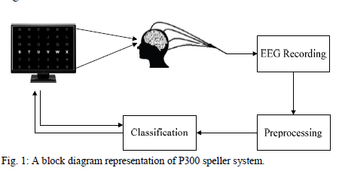
Introduction

Slide 7
Problem Statement

Slide 8
Problem Statement :
To develop an efficient, real-time system that:
Implements P300 speller
Gathers EEG data at appropriate intervals.
Analyses the EEG signals
Generates accurate output alphabets and numbers
Acts as a word suggestion tool.

Slide 9
Motivation

Slide 10
Motivation
One of the most significant characteristics of human beings is their capability to communicate. The richness and complexity of communication between people play an important role in relationships.However, direct conveyance of emotions, concepts and thoughts from one brain to another brain is still impossible.
They have to be converted into verbal/written messages, drawings, gestures or other distinguishable expressions.
Typically, written and verbal communications are sent using the throat, mouth and hands, although the expressions are generated earlier in the human brain.

Slide 11
Motivation
However, severely disabled people are unable to use the typical output channels for communication.
So they need effective tools like BCI for effective communication using eye blinks , concentrating on a particular command etc.
The number of potential users for BCIs is high, since there are many people worldwide suffering from long-term or life-long disability .
People are suffering from disease like Amyotrophic Lateral Sclerosis(ALS) which attacks motor neurons in the brain resulting in complete and permanent paralysis.

Slide 12
Motivation
Still, these patients are fully conscious, and have needs, feelings and a deep desire to communicate with others.
BCI technology would be of great help for communicating with such patients
These factors motivates to focus on brain-computer interfaces in this study, and particularly on the P300 spelling paradigm, which has been investigated in several studies due to its importance.

Slide 13
Literature Survey

Slide 14
Survey 1 : “Talking off the top of your head: toward a mental prosthesis utilizing event-related brain potentials”
This paper was proposed by L.A. Farwell and E. Donchin and accepted for publication in 1988.
Paper describes the development and testing of a system for communication through a computer, using the P300 component of the ERPs. Display screen contains 26 alphabets together with some extra symbols and commands which serve as the keyboard or prosthetic device.
It studied 5 healthy volunteers who used the system to communicate a 5 letter word to a computer and the primary purpose was to determine the number of trials and the rate of event presentation that are required to achieve a specific level of accuracy in communication.

Slide 15
Survey 1
Four different algorithms were used to compute the scores: Stepwise linear discriminant analysis (SWDA), Peak Picking, Area and Covariance. The values obtained from above analyses were then used to determine the letter upon which the subject was focusing attention.
A low rate of communication was achieved at 1 character every 26 seconds or 2.3 chars per minute.They also used data from only 5 subjects, so it didn’t perform well across subjects and across sessions.
Link:http://www.farwellbrainfingerprinting.com/pdf/Farwell-Donchin-1988-Talking-Off-the-Top-of-Your-Head-BCI-brain-computer-interface.pdf

Slide 16
Survey 2 : “BCI Competition III: Dataset II - Ensemble of SVMs for BCI P300 Speller”(2008)
This paper was proposed by Alain Rakotomamonjy and Vincent Guigue and accepted for publication as a transaction paper in 2008 by IEEE.
Classification methods, like SVM and LDA were used in P300 based BCI.
BCI competitions allows the community to benchmark several classification techniques in an unbiased way. Indeed, the development and test data are provided by BCI laboratories but the truth about test data are not known by competitors.
This paper presents the algorithm that has provided the best classification performance on the dataset produced by a P300 speller matrix during the BCI III competition.

Slide 17
Survey 2
It uses P300 speller for recording brain signals and it is based on the oddball paradigm which states that rare expected stimuli produce a positive deflection in the EEG after about 300ms. P300 speller has been introduced by Farwell & Donchin which was published in 1988.
A multiple classifier system is developed for each subject and each of the single classifier is a linear support vector machine .They achieved a correct classifier performance of 73.5% and 96.5% for respectively 5 and 15 character sequences and this performance has been evaluated on a test set composed of 200 spelling characters.

Slide 18
Survey 2
Drawback of this paper is that it provides only offline analysis of the classification algorithms and online capacity has to be verified . Also BCI competition III has only provided datasets from 2 different subjects although from different acquisition sessions.
The algorithm used is not able to handle inter-subject variability since they have only used signals from the same subject for training and testing.This issue of inter-subject learning is important in order to make this BCI speller efficient with a new patient and without the need of a training session
Link: https://ieeexplore.ieee.org/document/4454051

Slide 19
Survey 3 : “BCI Competition 2003—Data Set IIb: Support Vector Machines for the P300 Speller Paradigm”
This paper was proposed by Matthias Kaper, Peter Meinicke, Thomas Lingner and accepted for publication as a transaction paper in 2004 by IEEE.
In this paper they propose to use SVM(Support Vector Machine) to analyse data from the P300 speller paradigm. They performed a P300 speller paradigm in which a subject is presented a 6x6 matrix, containing 36 symbols. Each row and each column is highlighted once within one trial. If the symbol, to which the subject attends, gets highlighted, a P300 component occurs in the EEG.

Slide 20
Survey 3
They trained an SVM algorithm for binary classification in a training set labeled with “1” and “-1” for P300 presence/absence, and computed the value of its discriminant function within a test set, with a high score indicating presence of a P300.
By performing five-fold cross validation on the training set they obtained optimal values for the parameters of SVM by which an accuracy of 84.5% for separation of P300 from non-P300 signals on training set was achieved.
The algorithm was trained and tested on the dataset provided by the BCI laboratories and their is future scope of practical realization with an online scenario.

Slide 21
Survey 4 : “Score normalization of Ensemble SVMs for BCI P300 Speller” (2017)
This paper was proposed by Sourav Kundu and Samit Ari and accepted for publication as a conference paper in 2017 by IEEE.
Used the ensemble technique for reducing classifier variability
Since in multi classifier system the averaged score can be affected by one classifier as the score of different classifiers are not in the same level so they used normalization methods to normalized the scores of each of classifiers.
Different Score Normalization Techniques for ESVM are used ,i.e,
Min-Max Normalization
Z-Score Normalization
Median Absolute Deviation (MAD)

Slide 22
Survey 4
Used the BCI Competition 3- Dataset 2 for training and testing and also it contained data about only 2 subjects
The proposed Min-Max normalization achieves 76% on 5 epoch and 97% on 15 epoch compared to initial method of 73.5% and 96.5% and in case of Z-score the accuracy is 75.5% and 97.5% and for MAD it is 76% and 98%.
Drawbacks are that algorithms are tested on the dataset provided by BCI and their performance is not checked on real-time data and also since the dataset contains data about only 2 subjects therefore they perform badly for inter-subject testing.
Link: https://ieeexplore.ieee.org/document/8204119

Slide 23
Survey 5 : “The BCI Competition 2003: Progress and Perspectives in Detection and Discrimination of EEG Single Trials”
This paper was proposed by Benjamin Blankertz, Gabriel Curio, Niels Birbaumer and Michael Schröder and accepted for publication as a transaction paper in 2004 by IEEE.
This data set, i.e., BCI Competition III Dataset II, represented a complete record of P300 evoked potentials (three sessions from one subject) recorded with the Wadsworth BCI2000 software using the paradigm described in and originally by Farwell and Donchin.
The objective in the contest was to use the data from two sessions (i.e., 42 characters) to train a classifier and to then predict the 31 characters in the one remaining session.

Slide 24
Survey 5
The user was presented with a 6 by 6 matrix of characters. The user’s task was to focus attention on characters in a word that was prescribed by the investigator (i.e., one character at a time). The six rows and six columns of this matrix were successively and randomly intensified at a rate of 5.7 Hz. Two out of 12 intensifications of rows or columns highlighted the desired character (i.e., one particular row and one particular column).
Signals were collected from one subject in three sessions and digitized at 240 Hz. Each session consisted of a number of runs. In each run, the subject focused attention on a series of characters. It was concluded that 5 epochs produced the same result as 15 epochs.

Slide 25
Literature Survey Conclusion:
Since all these proposed system are based on the offline data that are provided by BCI there is little knowledge about the performance of these same algorithms on real-time EEG data.
Also the dataset provided only consist of 2 or 5 subjects which leads to less accurate results for person not present in the training and testing phase.
So, we aim to work on getting the performance of SVM algorithm on the real-time EEG data and provide good accuracy in the classification results of the target character.

Slide 26
Proposed System Design

Slide 27
Proposed System Design :
The P300 speller system will comprise of the following hardware and software modules:
8-channel Enobio EEG machine
NIC software (compatible with the Enobio machine)
P300 Speller GUI
Machine Learning module

Slide 28
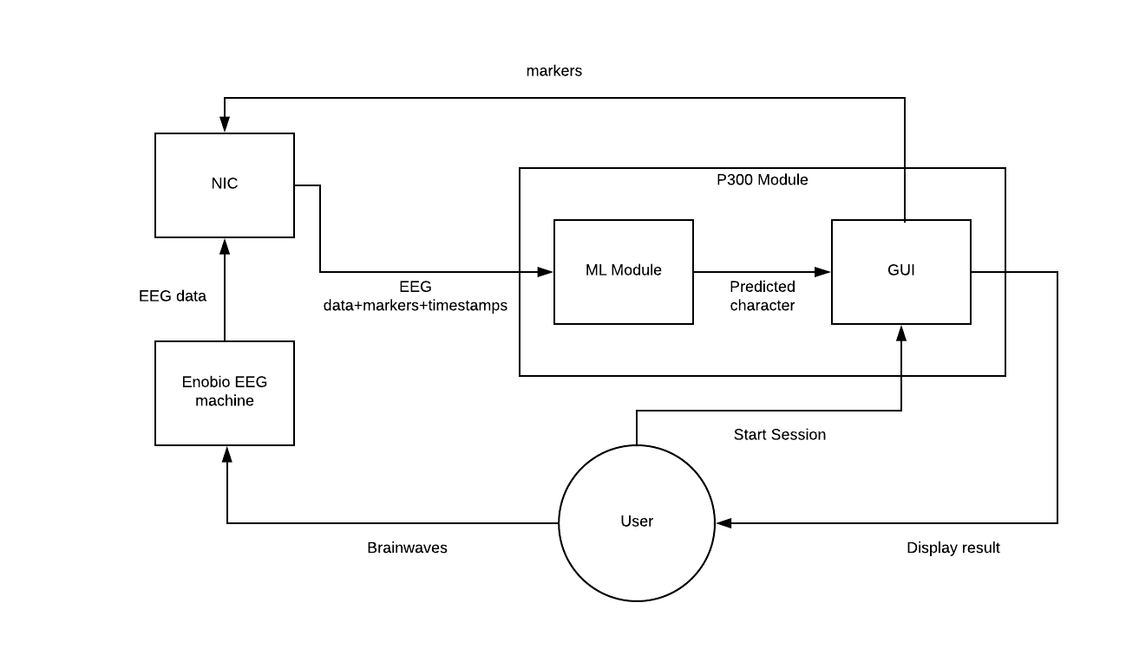

Slide 29
Proposed System Design : Enobio EEG
The Enobio EEG machine is an 8-channel, dry electrode headwear.
The electrode arrangement for our system has been chosen such that the EEG signals pertinent to our application will be recorded.
The Enobio EEG device is capable of recording EEG readings every 2 milliseconds, which will ensure that sufficient data is recorded per epoch.

Slide 30
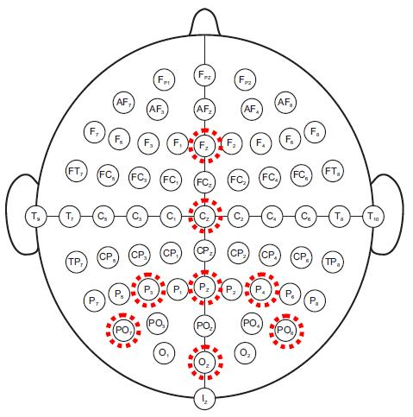
Proposed System Design : Enobio EEG
10-20 system connection for Detecting P300 signals:

Slide 31
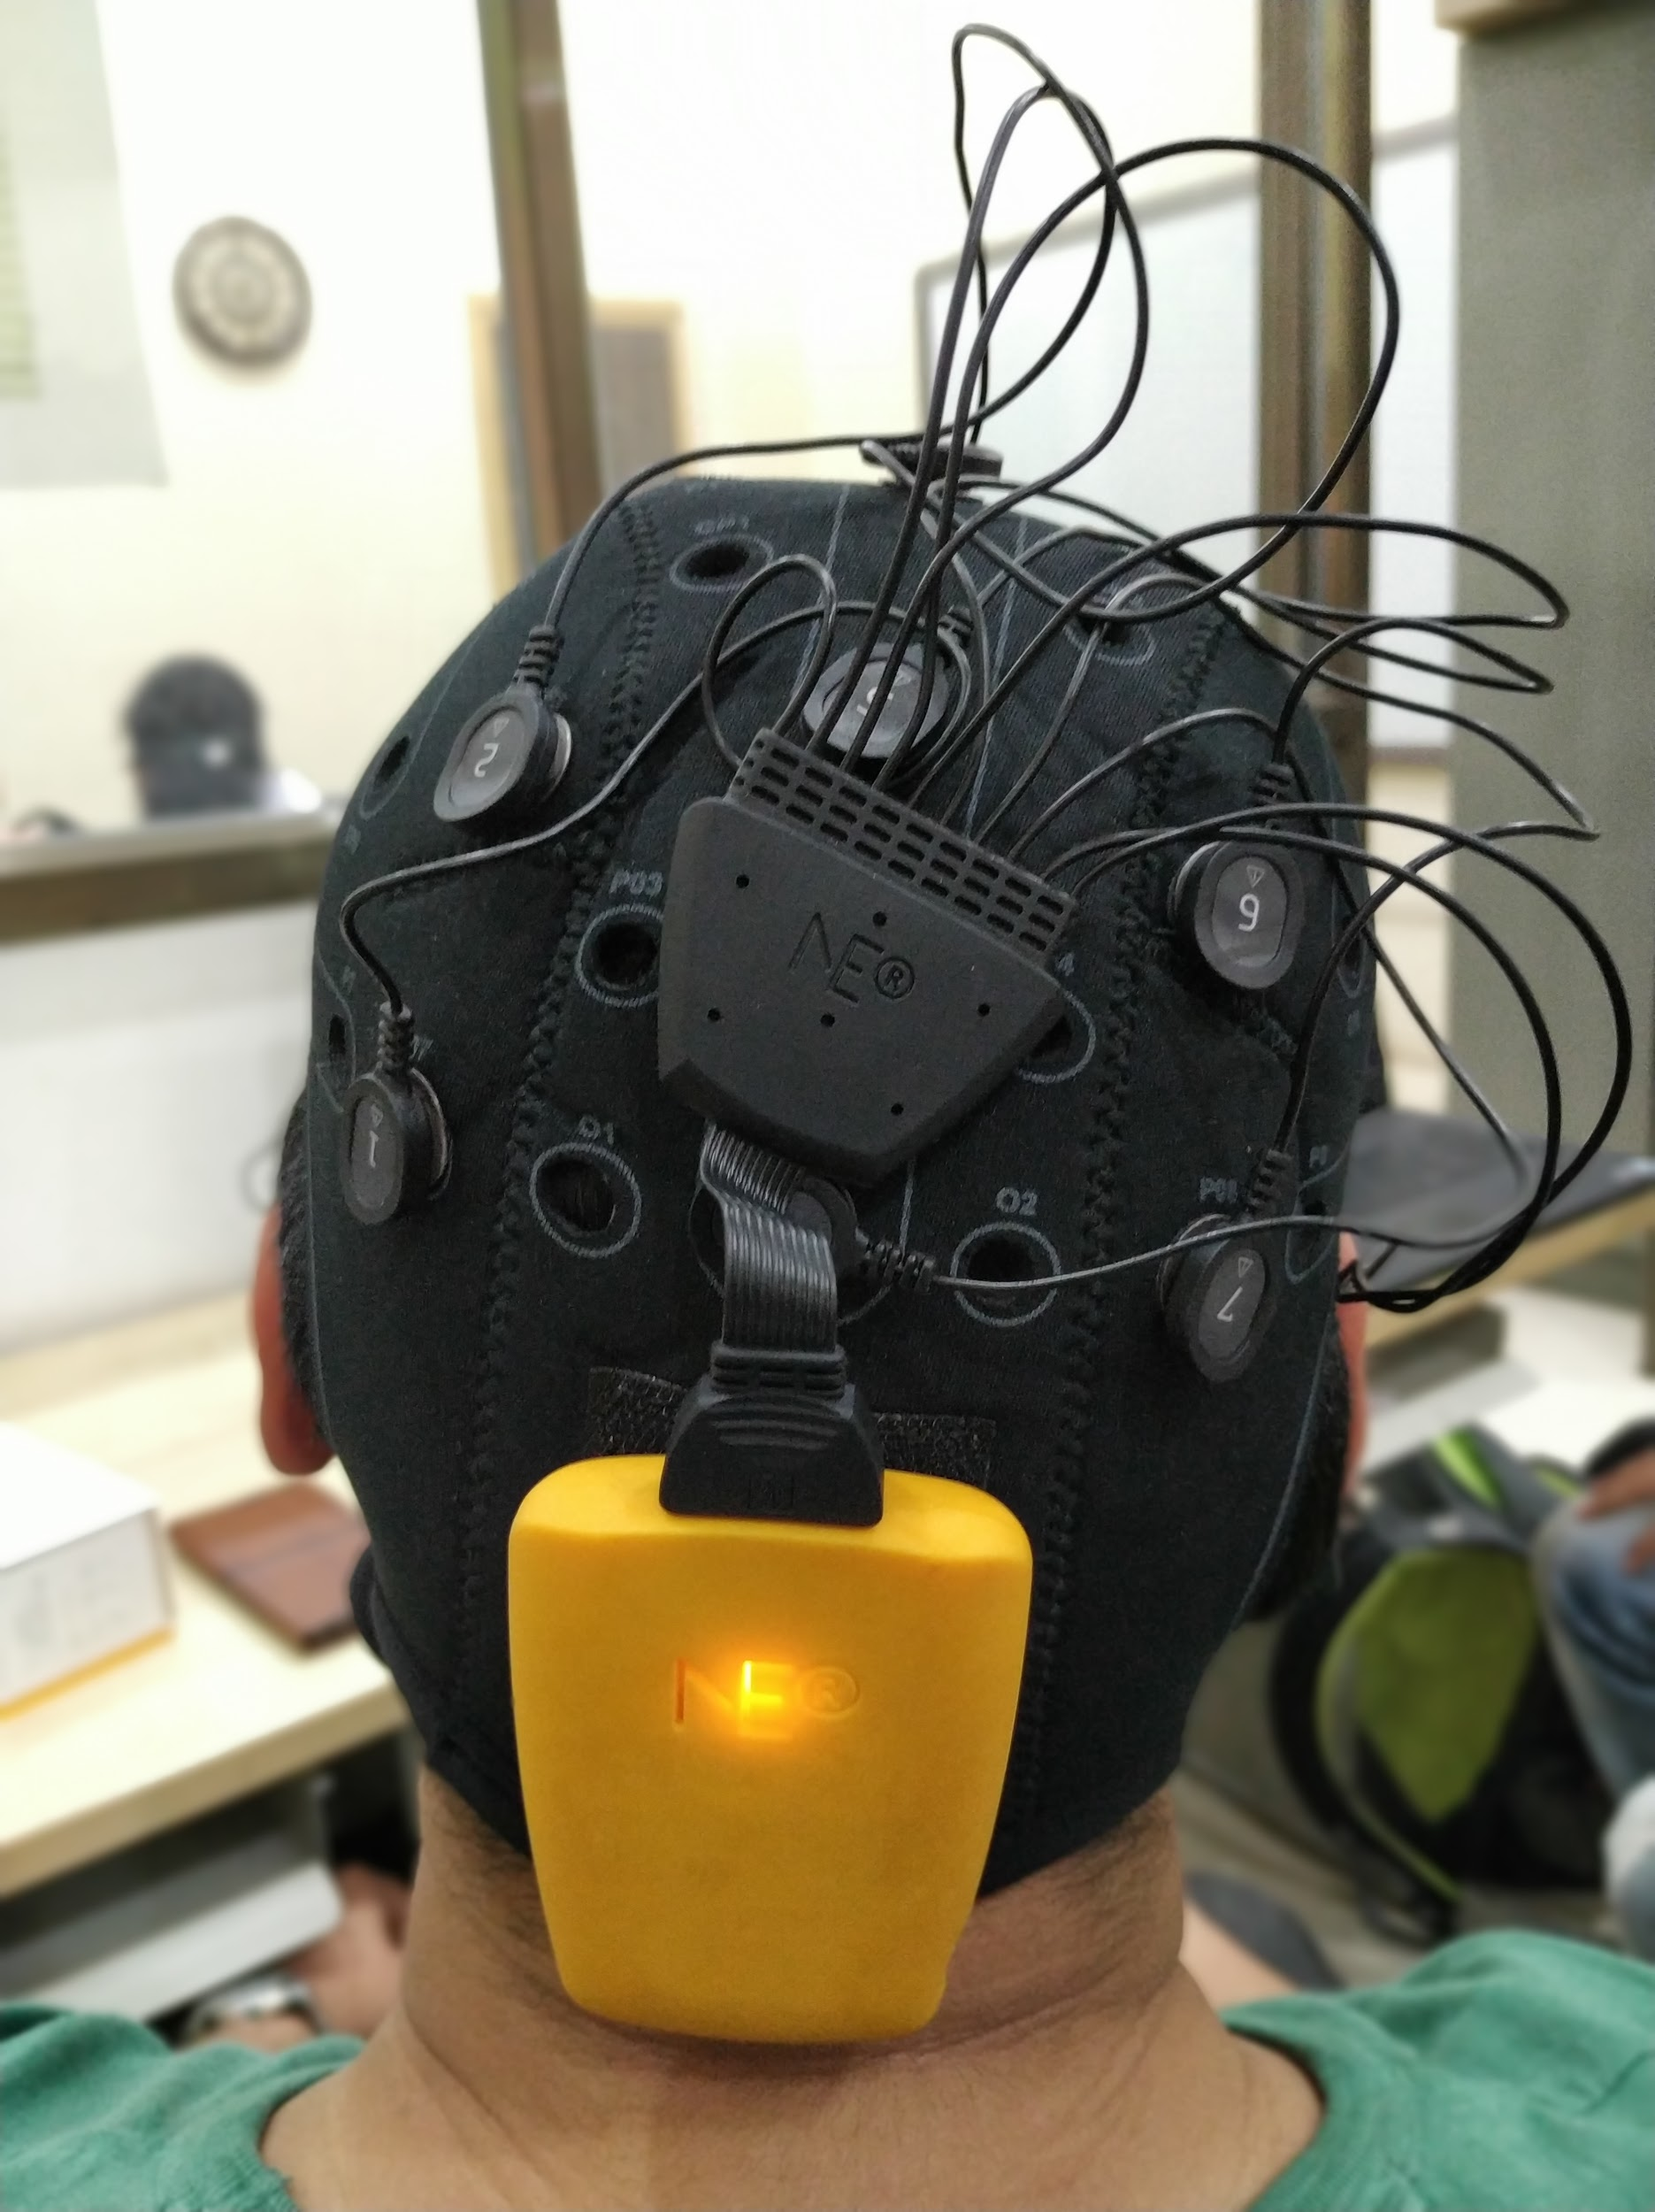
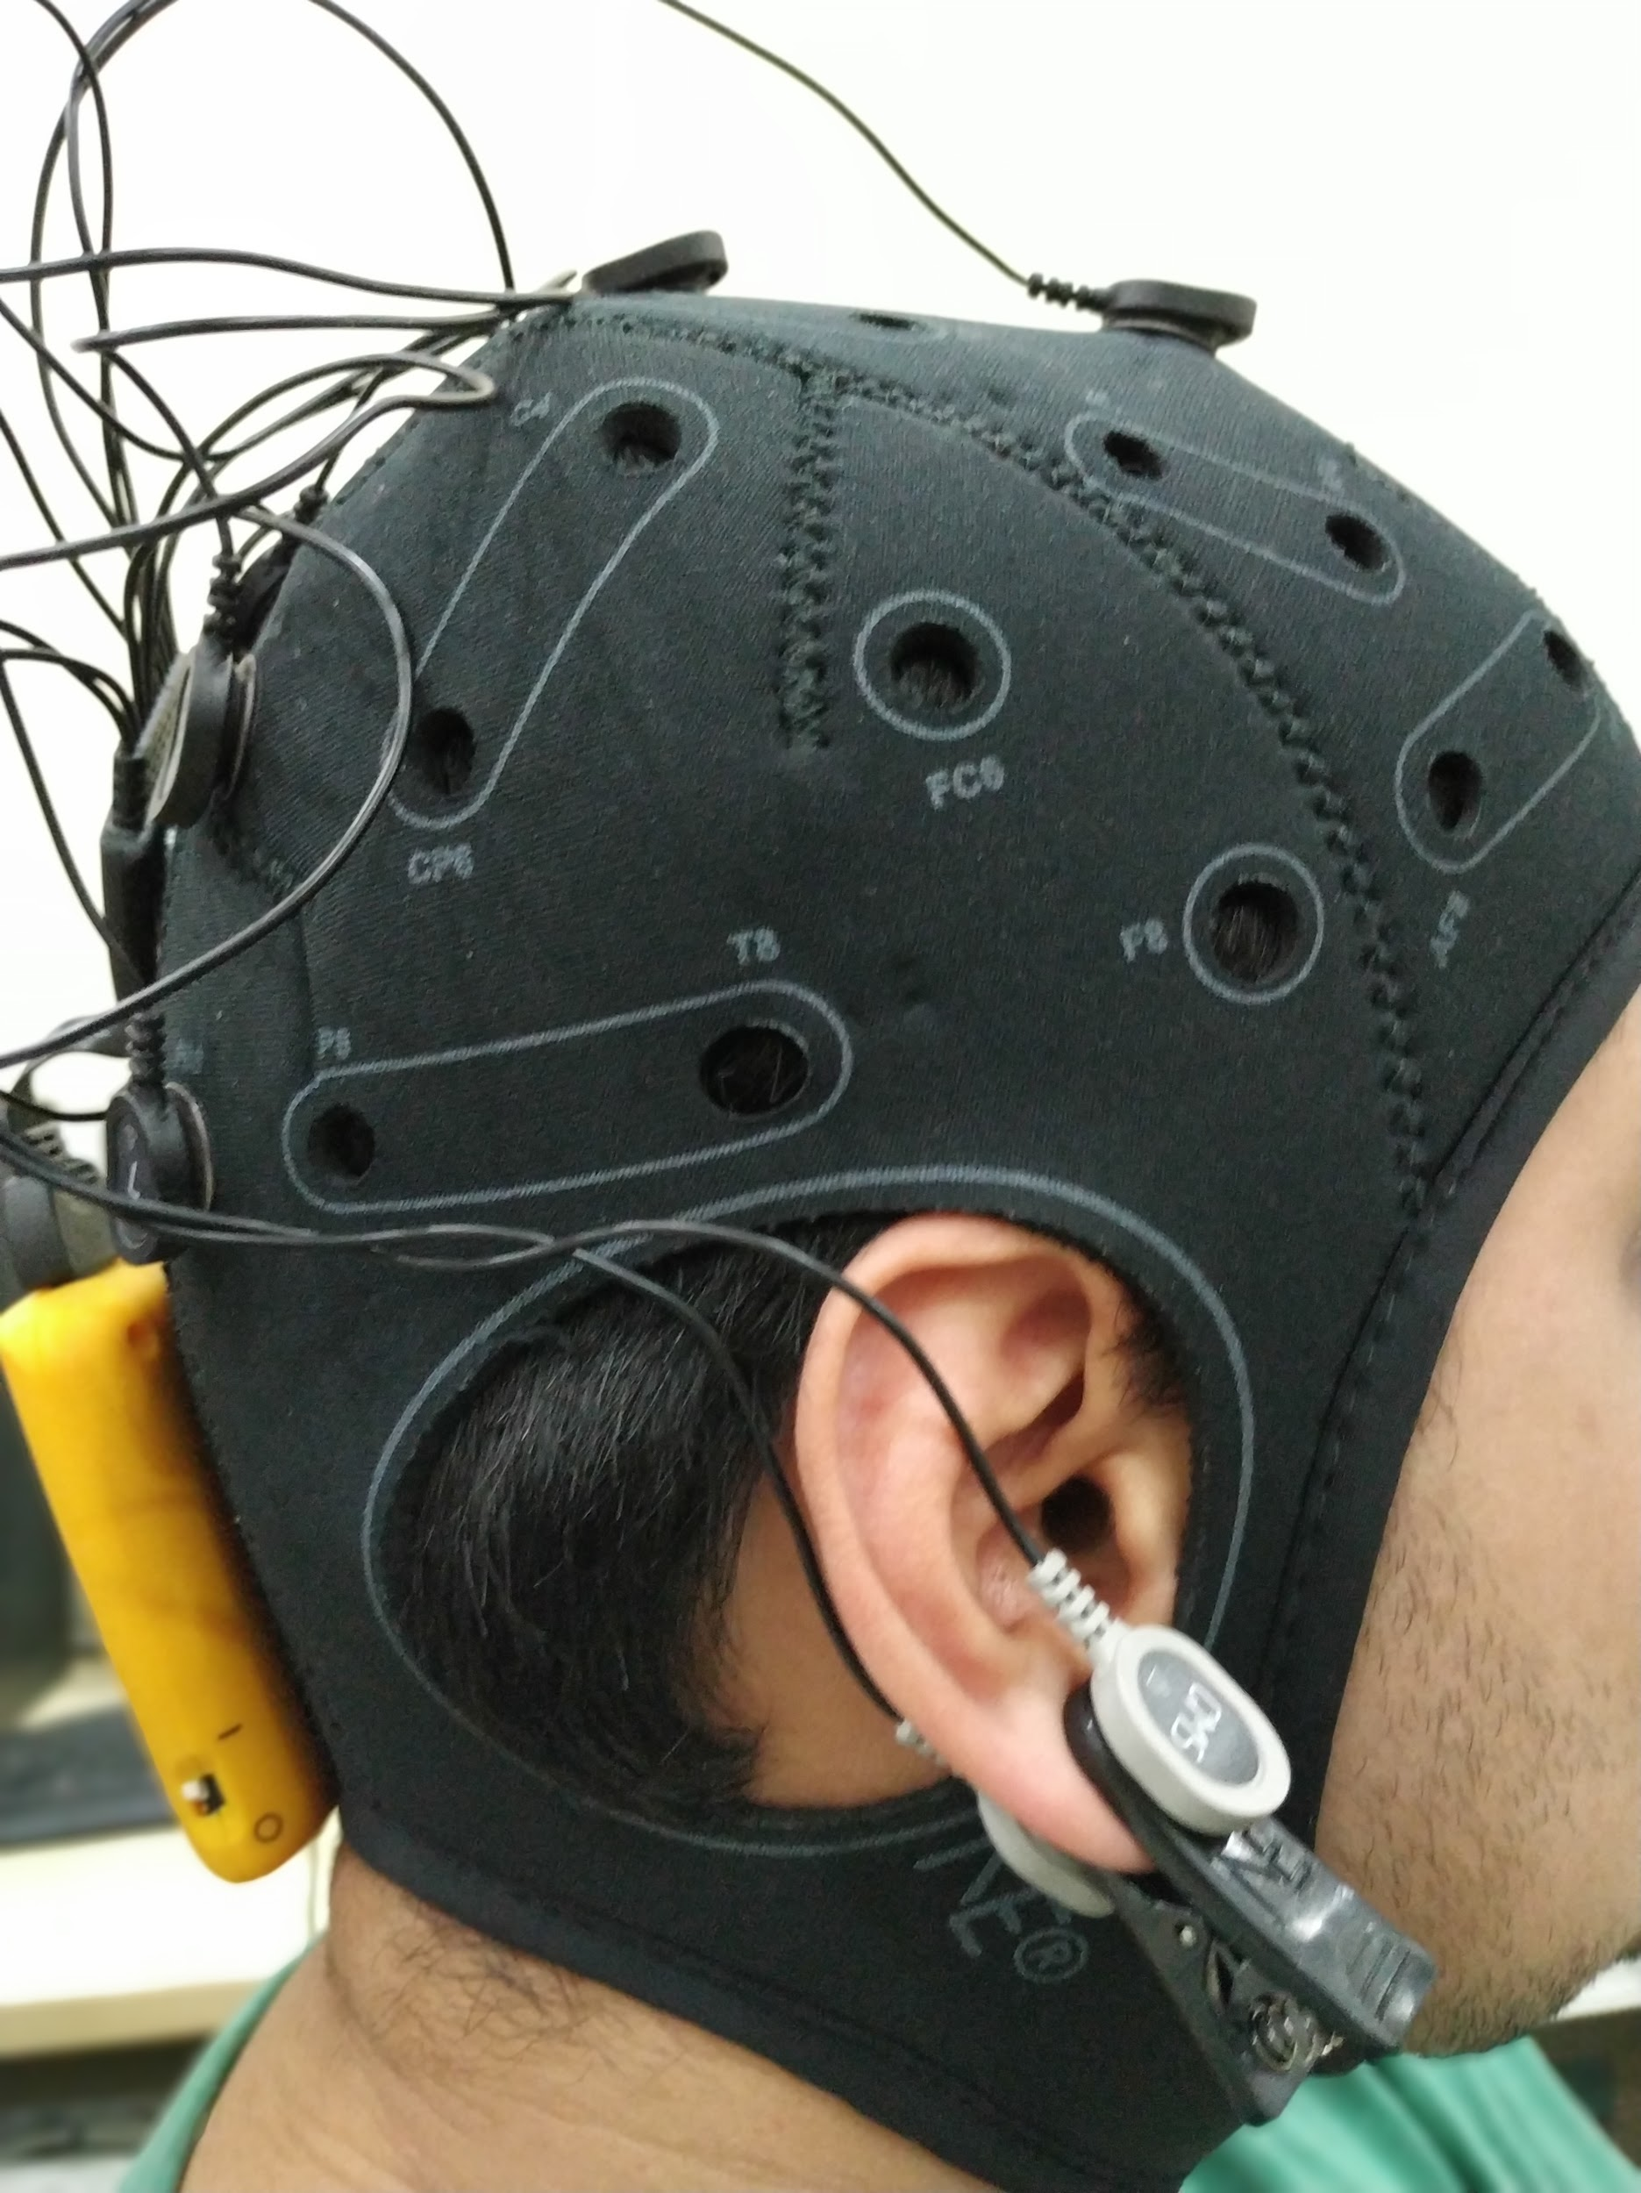
Images of Enobio 3G (8 Channel)

Slide 32
Proposed System Design : NIC
Neuroelectrics Instrument Controller (NIC):
NIC is a software developed for the Enobio EEG machine.
It has features that allow us to view the recorded EEG signals as a graph as well as save the EEG readings in a .easy file format along with a timestamp and a marker to denote their significance.
The marker field is used to record the row or column number of a particular intensification during an epoch.
The other fields that are recorded include the timestamp field and one field each for the electrode readings.

Slide 33
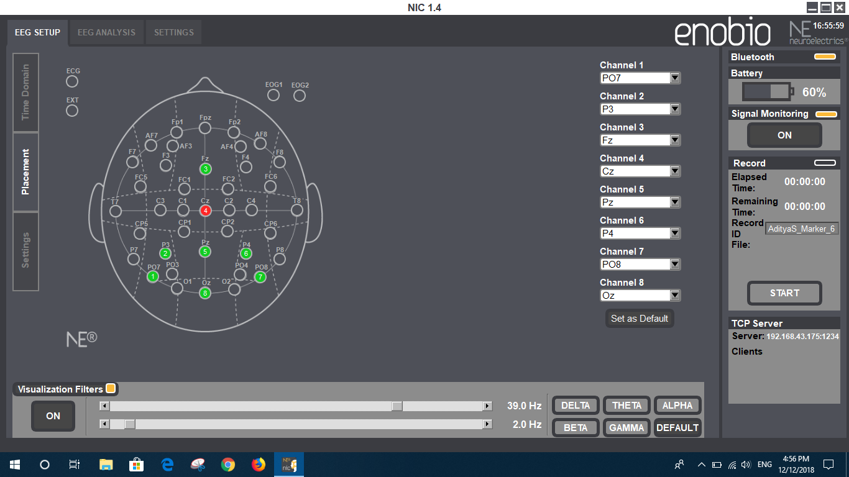
Snapshots of NIC

Slide 34
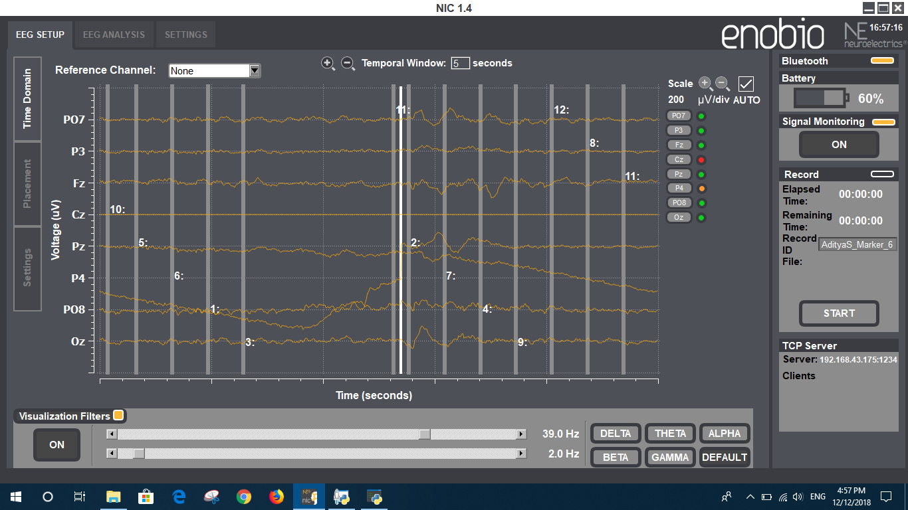
Snapshots of NIC

Slide 35
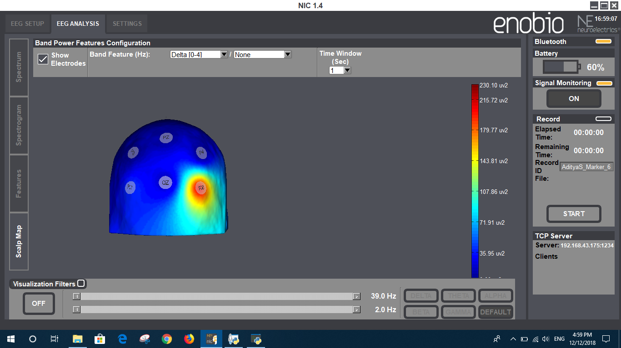
Snapshots of NIC

Slide 36
Proposed System Design : P300 GUI
The P300 GUI has been written in Python and can be used in two modes: Training and Testing.
It includes a P300 speller display that can intensify the rows and columns of the P300 speller grid.
It connects to NIC using the labstreaminglayer (LSL) library and sends it markers for the row/column that was intensified.
It can also receive EEG data from NIC.

Slide 37
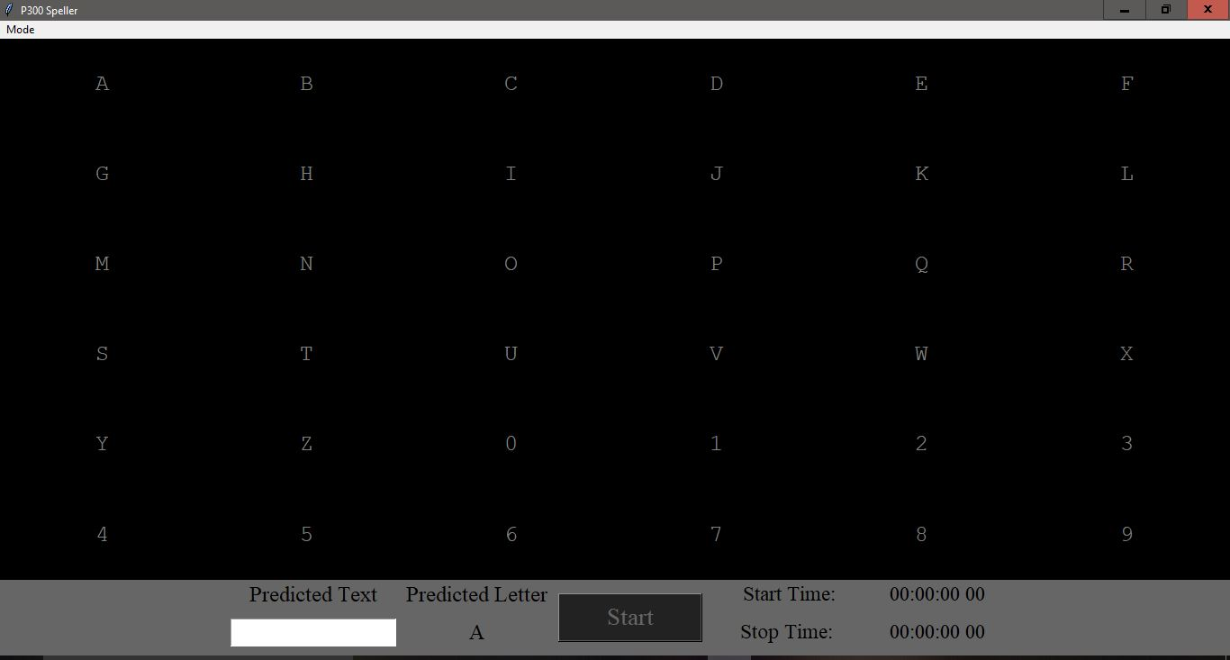
Snapshots of P300 GUI

Slide 38
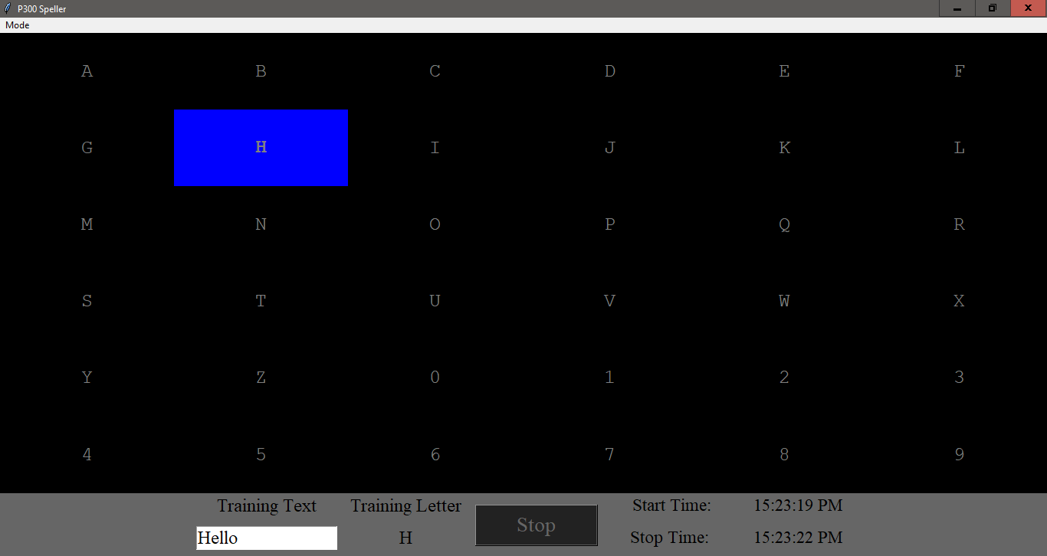
Snapshots of P300 GUI

Slide 39
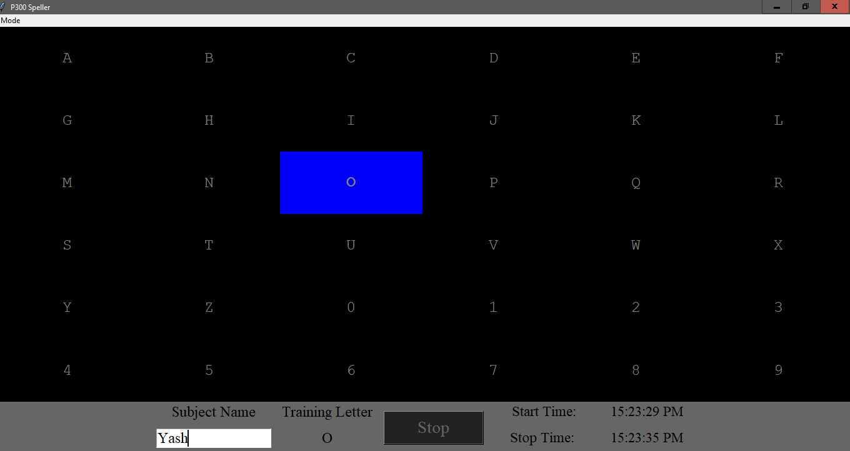
Snapshots of P300 GUI

Slide 40
Proposed System Design : ML Module
The data collected by the Enobio EEG machine will be provided as input to an ML Classifier model for training.
After the model has been trained then it will be used for real time letter prediction.
The proposed model for implementation is the Support Vector Machine (SVM) model.

Slide 41
Dataset

Slide 42
The Dataset
Data is collected in different sessions.
Every session is made out of various runs and for every run, a subject is asked to spell a character.
The character matrix is intensified for 100 ms and blank for 75 ms.
For one round there are 12 intensifications and for one character the sets of 12 intensifications are repeated 15 times (i.e., each row/column is intensified 15 times and thus there are 12∗15 = 180 total intensifications for single character).
Each repetition is called epoch. So, each character data consist of fifteen epochs.
The EEG data is collected continuously from 8-channels.

Slide 43
The Dataset
The data files generated by the Neuroelectric Interface Controller (NIC) are in the ‘.easy’ format.
The dataset consists of 10 columns.
The first 8 columns are for the 8 channels of the EEG machine and the remaining 2 columns are used for storing marker and timestamp.
The unit of the EEG sample is nano volts and its range is from +400000000nV to -400000000 nV.

Slide 44
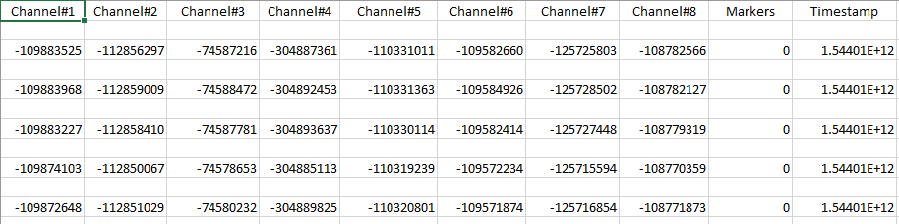
Snapshot of the Dataset

Slide 45
Algorithms

Slide 46
Task
Training by separation of data points representing a spike in the detected EEG brain signals from the usual stable state signals.
Identifying and mapping these surges with the characters on the P300 speller.
Swift prediction of data recorded and sent by the EEG machine.
A Machine Learning model based on Support Vector Machine classifier will be used for this purpose.

Slide 47

Support Vector Machines (SVM)
A non-probabilistic binary linear and non-linear classifier which can be used as a one-against-all classifier for a multi-class classification problem.
An SVM model represents the dataset as points in space, mapped in a way that separate categories are divided by a clear gap as wide as possible.
New data points are mapped onto the same space and predictions are made on the basis of the side of the separator on which they lie.

Slide 48
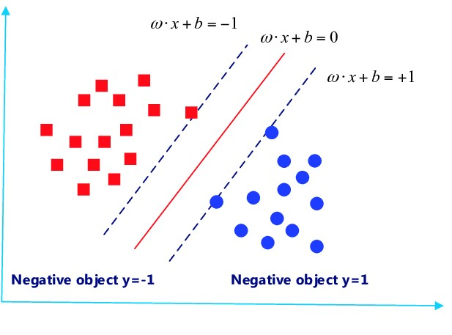
Diagrammatic representation

Slide 49
Why use SVM in this case?
Type of data: Here, based on the type of data, we will require a classifier which produces a non-linear boundary.
Higher accuracy: As compared to traditional classifiers like logistic regression and decision trees, results produced by SVM prove to be more accurate.
Handling outliers: Data recording involves infusion of noise, which can be handled by the SVM parameter ‘C’ doing the job of regularization.
No need of transforming data: Data transformation for better modelling is handled by SVM itself.

Slide 50
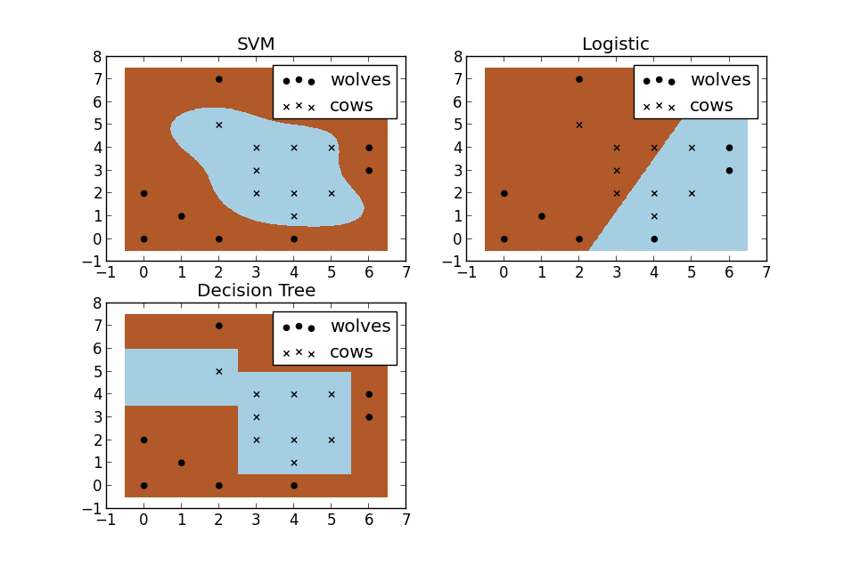
Comparison of SVM with traditional classifiers

Slide 51
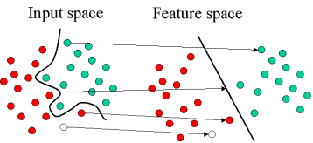
Transformation of data by SVM

Slide 52
Ensemble SVM
Averages out various classifier scores for a particular task to reduce variability produced by each one of them.
Employs one of the two methods:-
Bagging: Training on randomly chosen samples via a bootstrap technique.
Boosting: Training on samples based on their probability distribution, which is updated in proportion to the erroneousness of the sample.
Aggregation of individually trained SVMs to make decisions, is based on several methods like majority voting and least-squares estimation-based weighting.

Slide 53
SUMMARY
P300 speller for Brain-Computer Interface systems aims to provide a direct communication between computer-machine and human brain, without any muscular activity.
We aim to design a real-time EEG-based communication system using brain-computer interface (BCI) technologies implementing Machine Learning(ML) and using Enobio headset as an EEG Input system.
We propose to use the Support Vector Machines (SVM) classification technique.

Slide 54
SUMMARY
Our proposed system would have 4 modules namely: 8-channel Enobio EEG machine, NIC software (compatible with the Enobio machine), P300 Speller GUI and ML module.

Slide 55
Conclusion
Literature survey of the topic has been completed.
Requirements have been noted.
System design has been proposed and analysed.
Implementation of the P300 speller GUI is almost complete.
Communication mechanism between NIC and P300 speller GUI has been implemented.

Slide 56
References:
A. Rakotomamonjy, and V. Guigue, “BCI competition III: dataset II- ensemble of SVMs for BCI P300 speller,” IEEE Trans Biomed Eng, vol. 55, no. 3, pp. 1147-54, Mar, 2008.
L. A. Farwell, and E. Donchin, “Talking off the top of your head: toward a mental prosthesis utilizing event-related brain potentials,Electroencephalogr Clin Neurophysiol,vol. 70, no. 6, pp. 510-23, Dec, 1988.
S. Kundu and S. Ari, "Score normalization of ensemble SVMs for brain-computer interface P300 speller," 2017 8th International Conference on Computing, Communication and Networking Technologies (ICCCNT), Delhi, 2017.

Slide 57
References:
4) L. F. Nicolas-Alonso and J. Gomez-Gil, “Brain computer interfaces, a review,” Sensors, vol. 12, no. 2, pp. 1211–1279, 2012.
5) Chaurasiya, Rahul & Londhe, Narendra & Ghosh, S. (2015). An Efficient P300 Speller System for Brain- Computer Interface.
6) S. Xing, R. McCardle and S. Xie, "Reading the mind: The potential of electroencephalography in brain computer interfaces," 2012 19th International Conference on Mechatronics and Machine Vision in Practice (M2VIP), Auckland, 2012.

Slide 58
Thank You!

